Slide 1
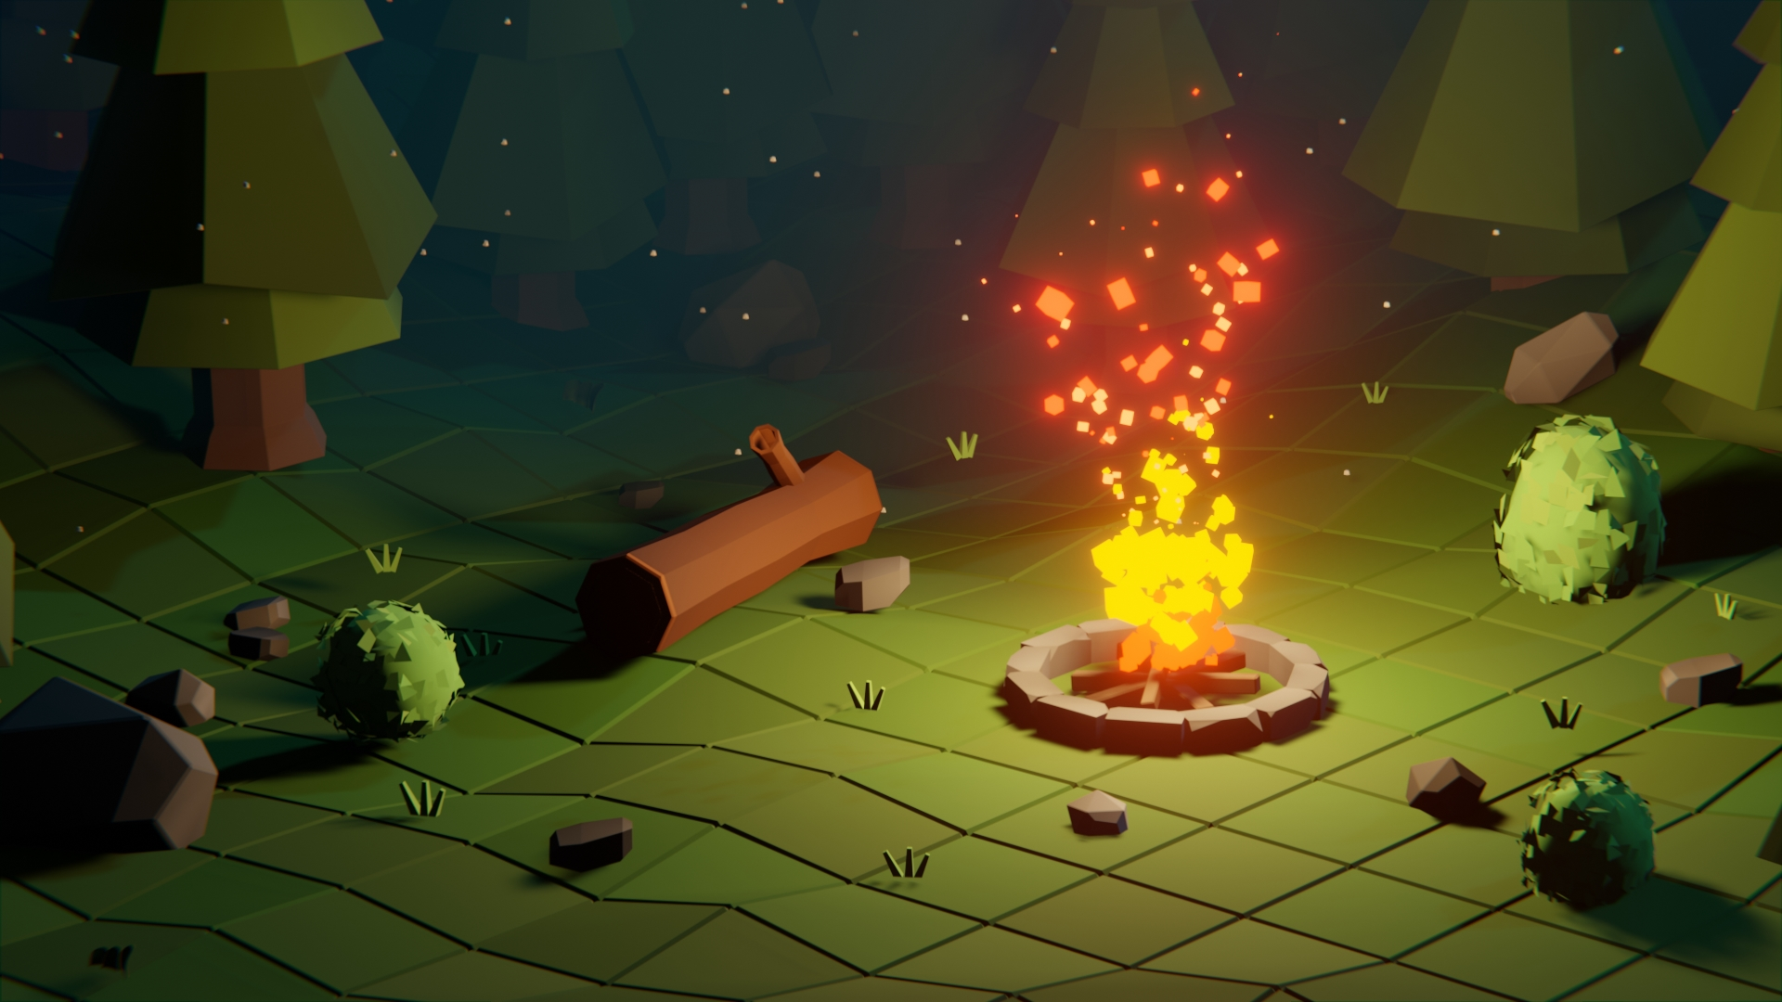
DIGITAL MEDIA PROJECT
Ashraya Singh Khatri
19031980
Internal Supervisor: Rakshak Bhushan Bajracharya
External Supervisor: Pooja Shrestha

Slide 2
Table of contents
Introduction
Aims and Objectives of the Project
Pre – Production
Production
Post- production
Testing and Evaluation
Conclusion

Slide 3
Introduction
The Digital Media Project presentation contains 10% of our module marks.
For this coursework, we students are required to complete our individual projects and submit the documentation, project files, and YouTube link to our supervisors, which should include the overall research, production process, evidence and testing of the product.
My project’s asset pack was created with the goal to provide an exciting and creative designs for aspiring new indie developers.

Slide 4
Aims and objectives of the project
One of the goal of my project is to create a low poly asset pack for the user, as it would lessen their production time and which will allow them to complete their task more effective and efficiently.
The asset pack is easily customizable, personalized and ready for gaming use.
I hope that the project will also motivate more individuals to learn and experiment with 3D modelling and animation, as well as develop their own unique and creative products.
The main objective of my asset pack is to provide a wide range of models to the gaming community which can be used in different settings of games.

Slide 5
Pre-production
This stage includes planning for the project. It includes the title of my project, the genre for the game, it’s targeted audience and the design and aesthetic for the game. During the pre- production stage I researched and look for reference to start my project.
So, in order to make different models with their unique aesthetics and world buildings I have searched on and came up with distinct references for my project.

Slide 6
Concept Art

Slide 7
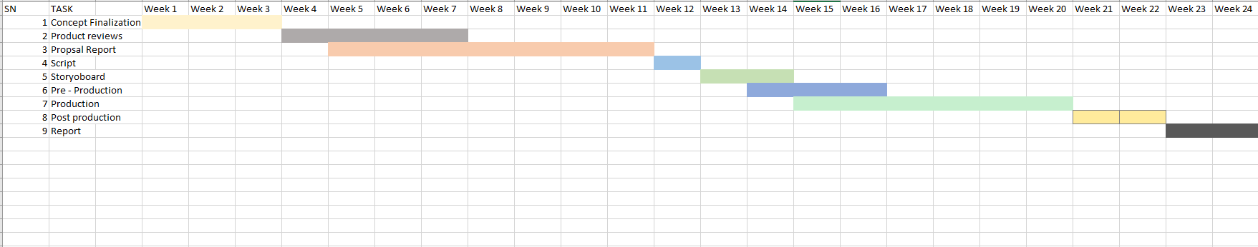
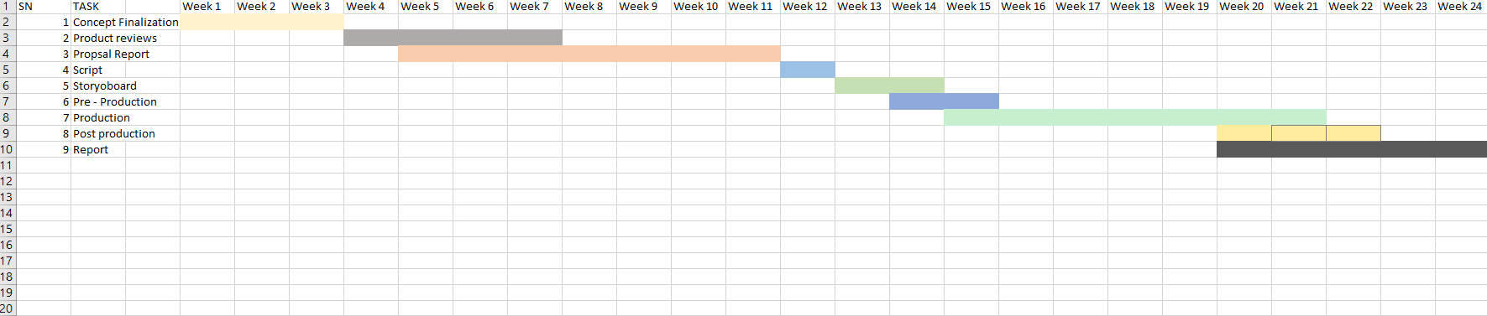
Project timeline and schedule

Slide 8
For the previous timeline of the project, lots of production processes were not properly followed. It was due to lack of a proper model process being not assigned to the project. However, the tasks for the project were divided into standard project planning, Pre-production. Production and Post- production. The production process was mentioned to start from week 15 to week 20. Thus, due to the project not being updated with the previous timeline the initial plan that was done for the DMP was updated with the new Gantt chart.
The production phase duration has increased giving more time to create models with proper shaders and lightning. Post-Production has been moved forward as to render the materials as quickly as possible.

Slide 9
Production
This phase included where the game assets were starting to get modelled per the concept art of my pre- production stage.
In this stage all the aspects of the products are created and enhanced. This stage plays a very vital role for the technical creation and aesthetic visuals which is implemented in the games.

Slide 10
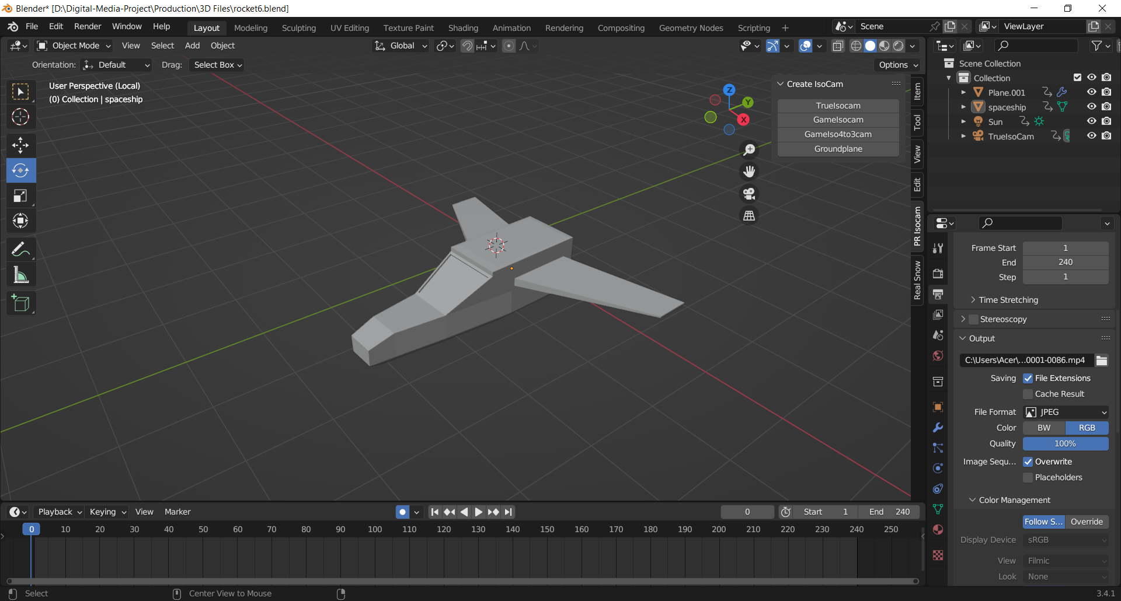
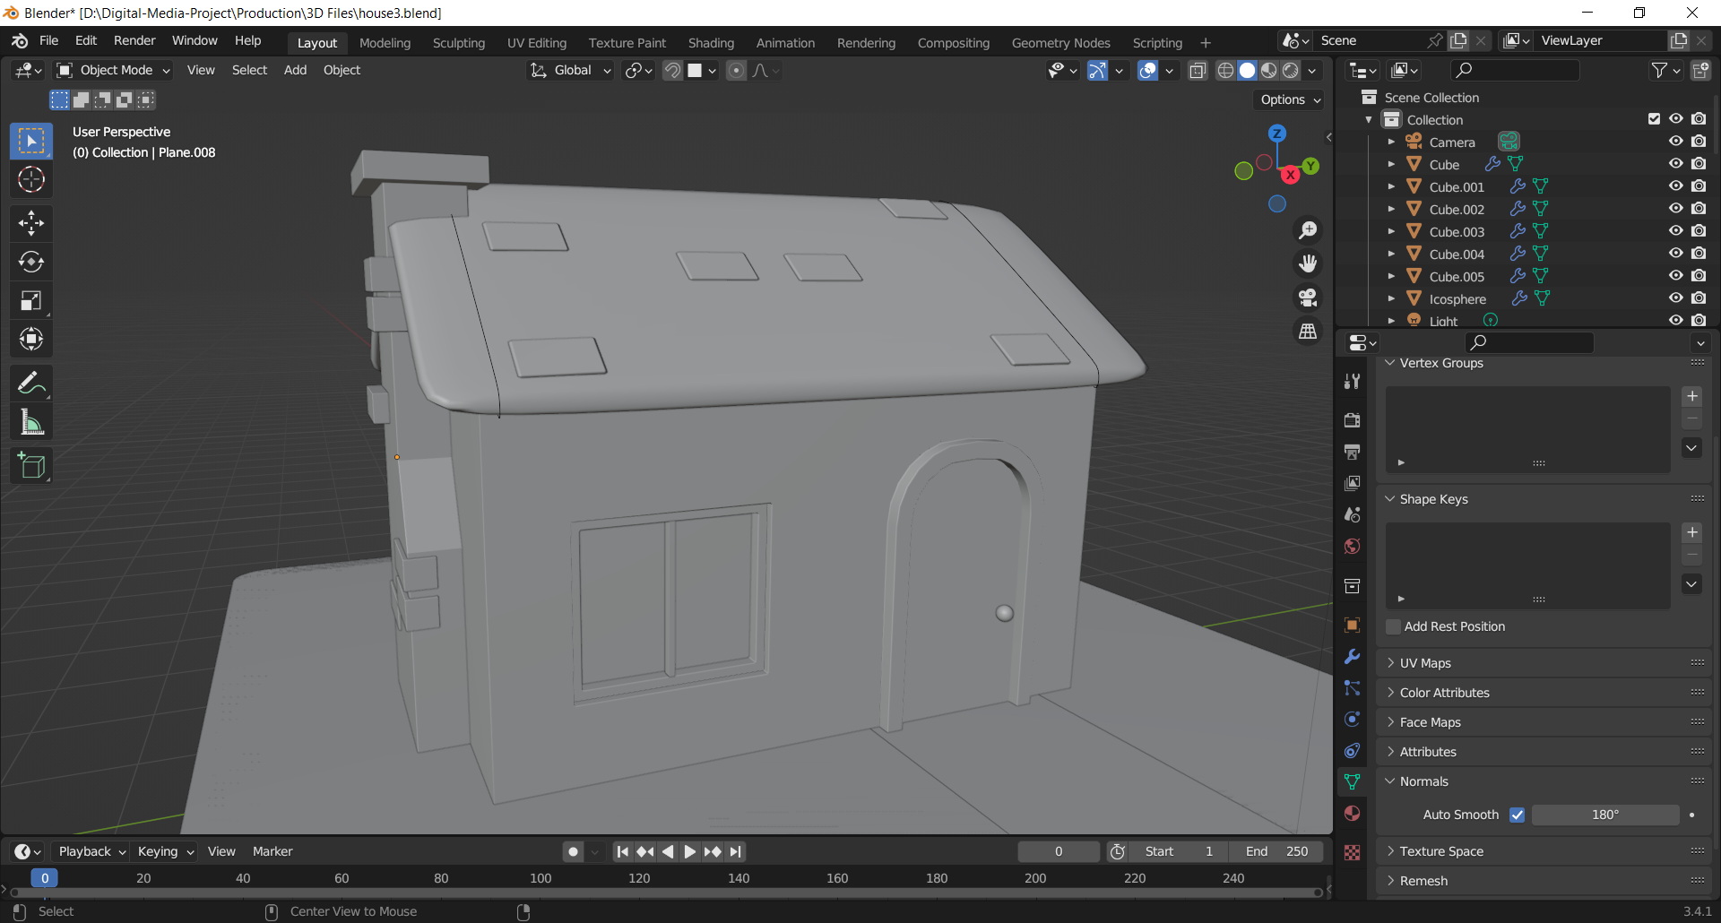
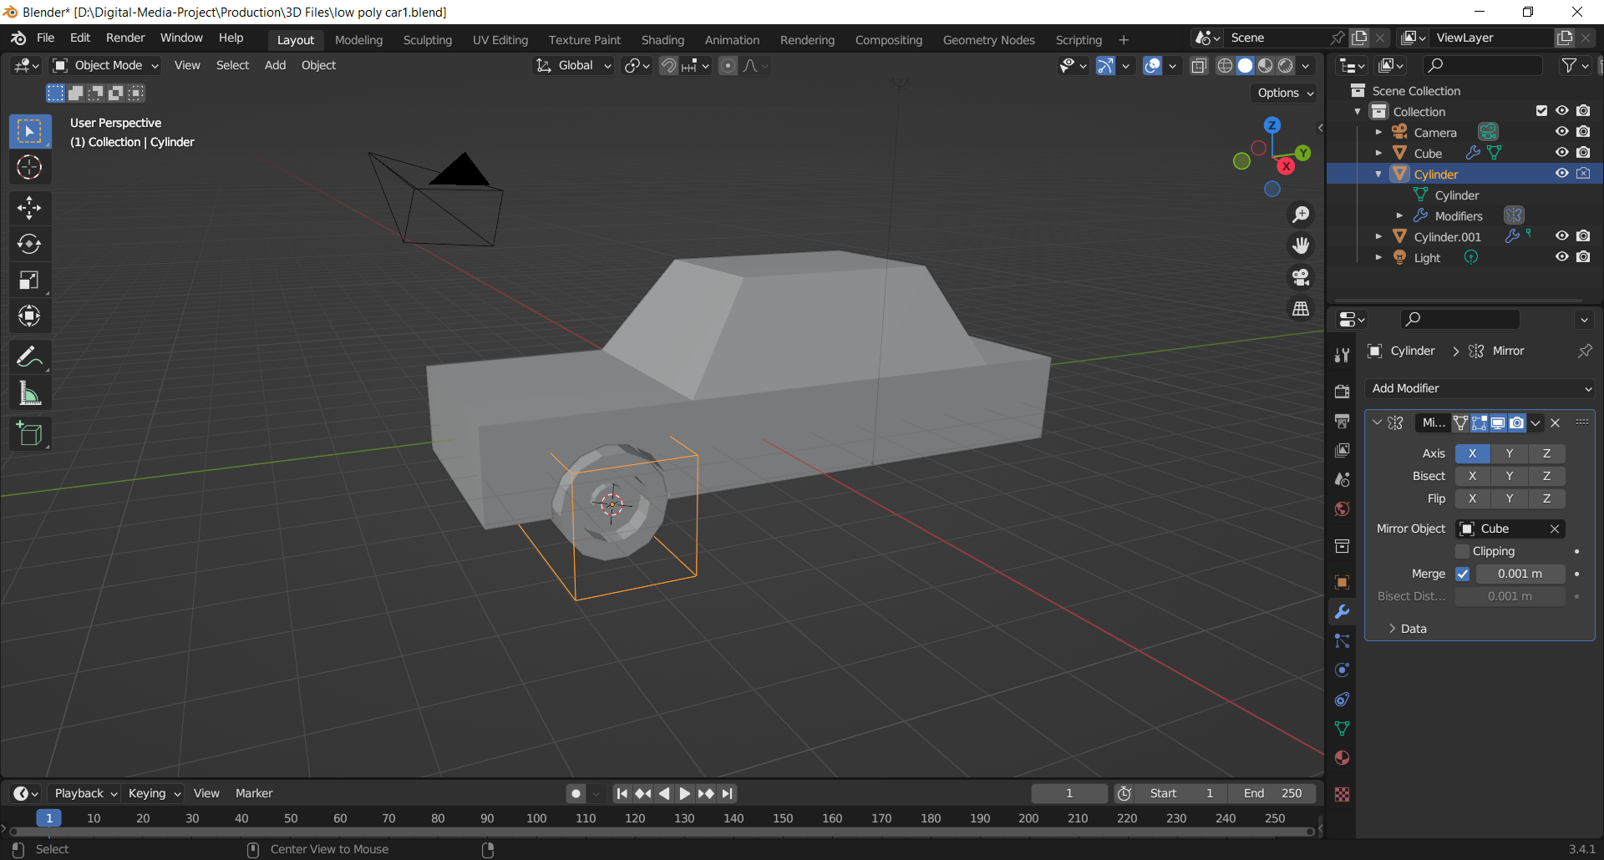
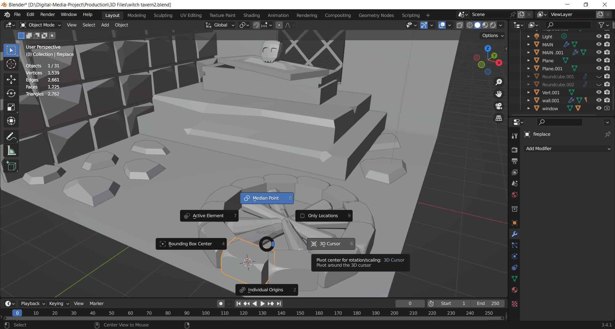
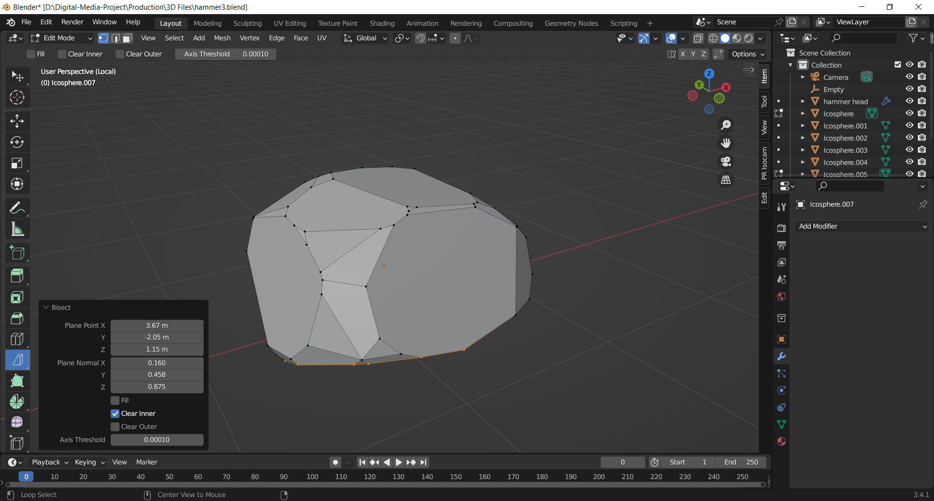
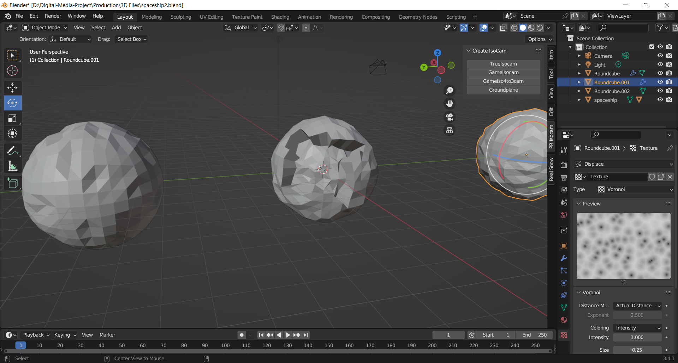
Modelling/Asset creations

Slide 11
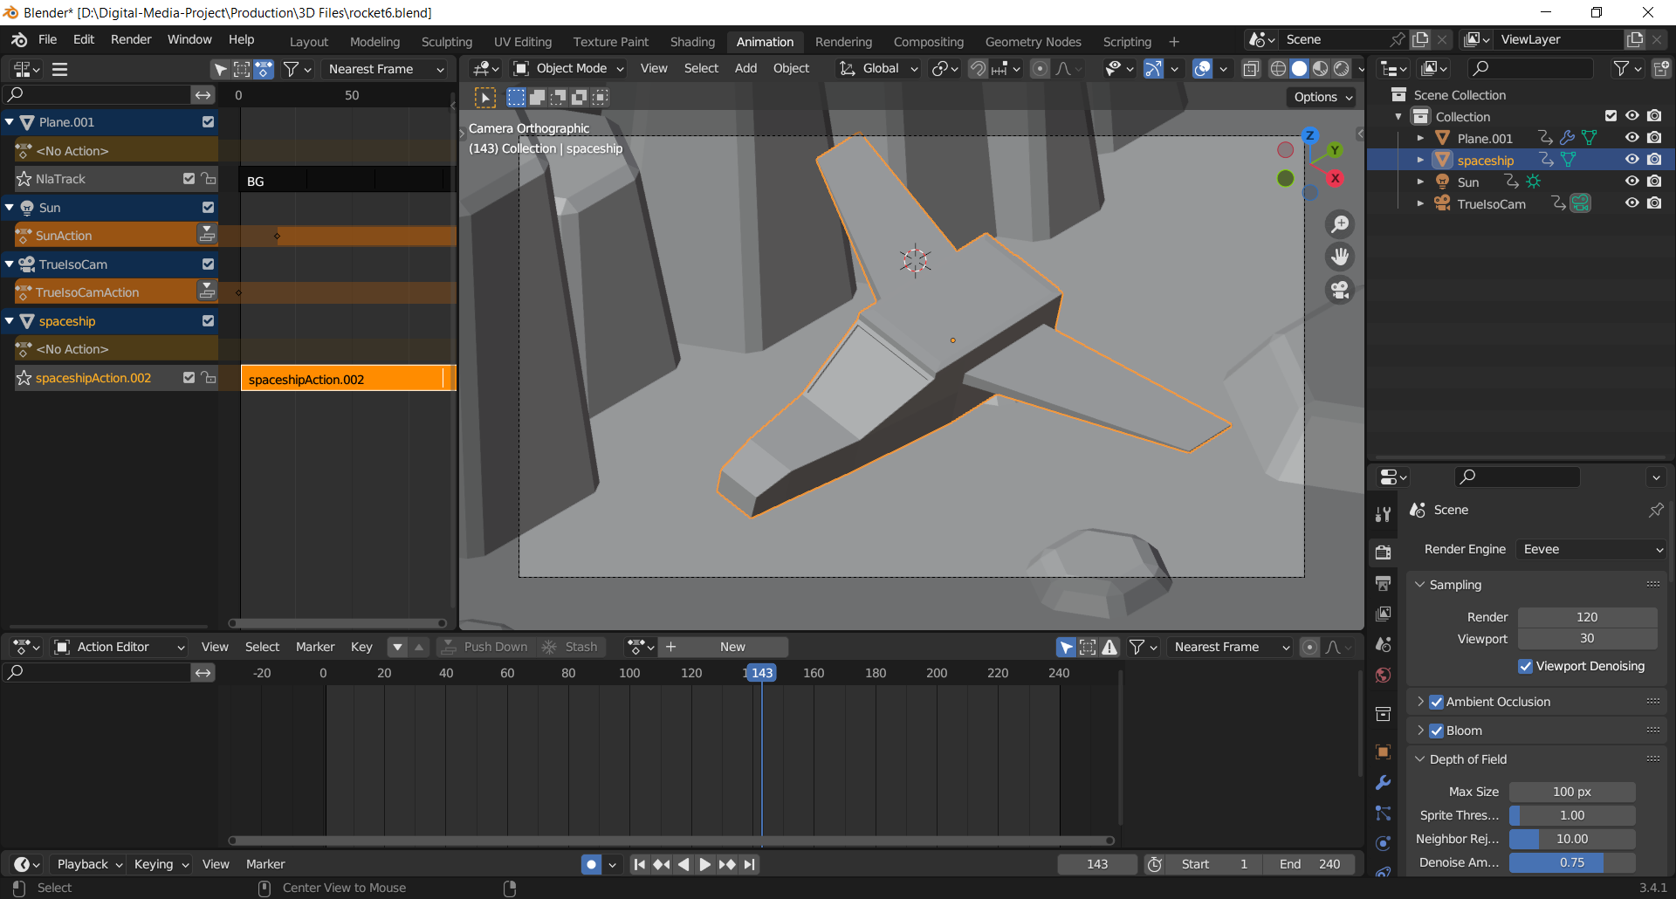
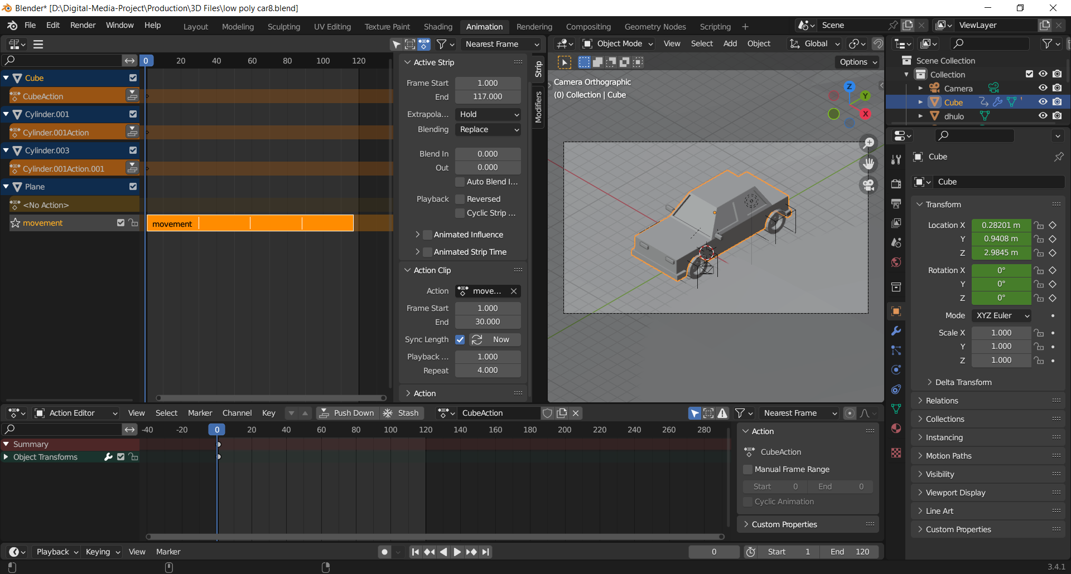
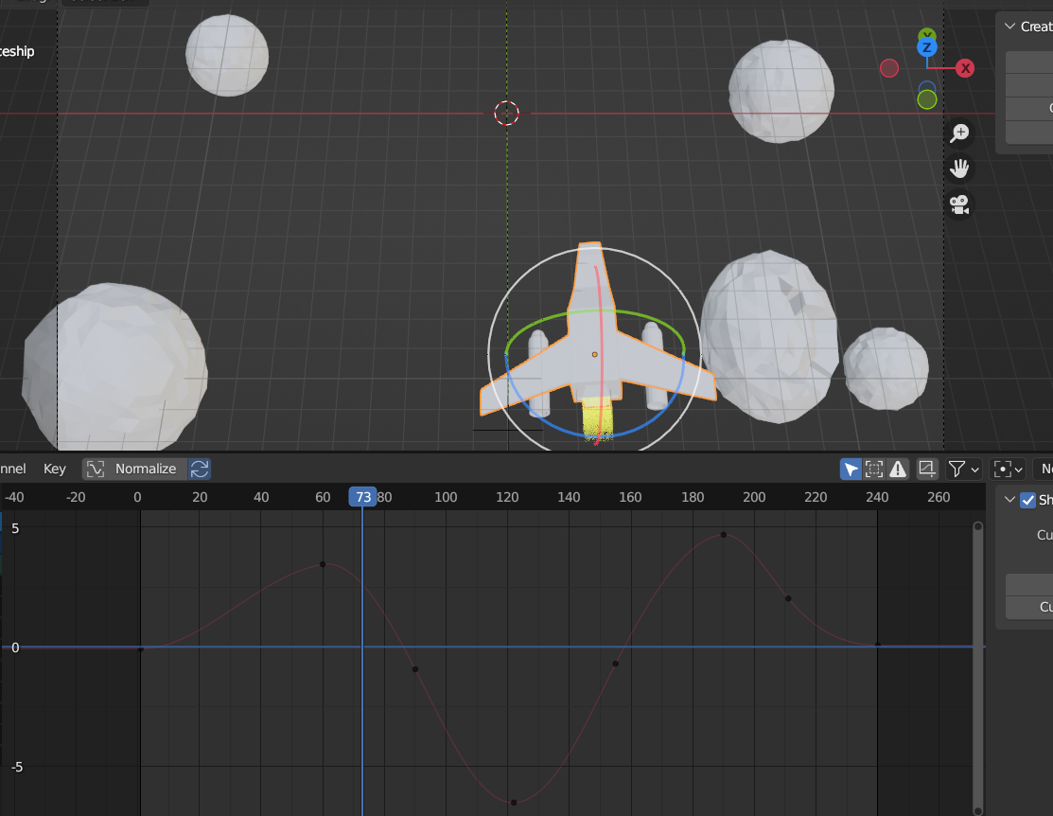
Animation loops and Particle effects

Slide 12
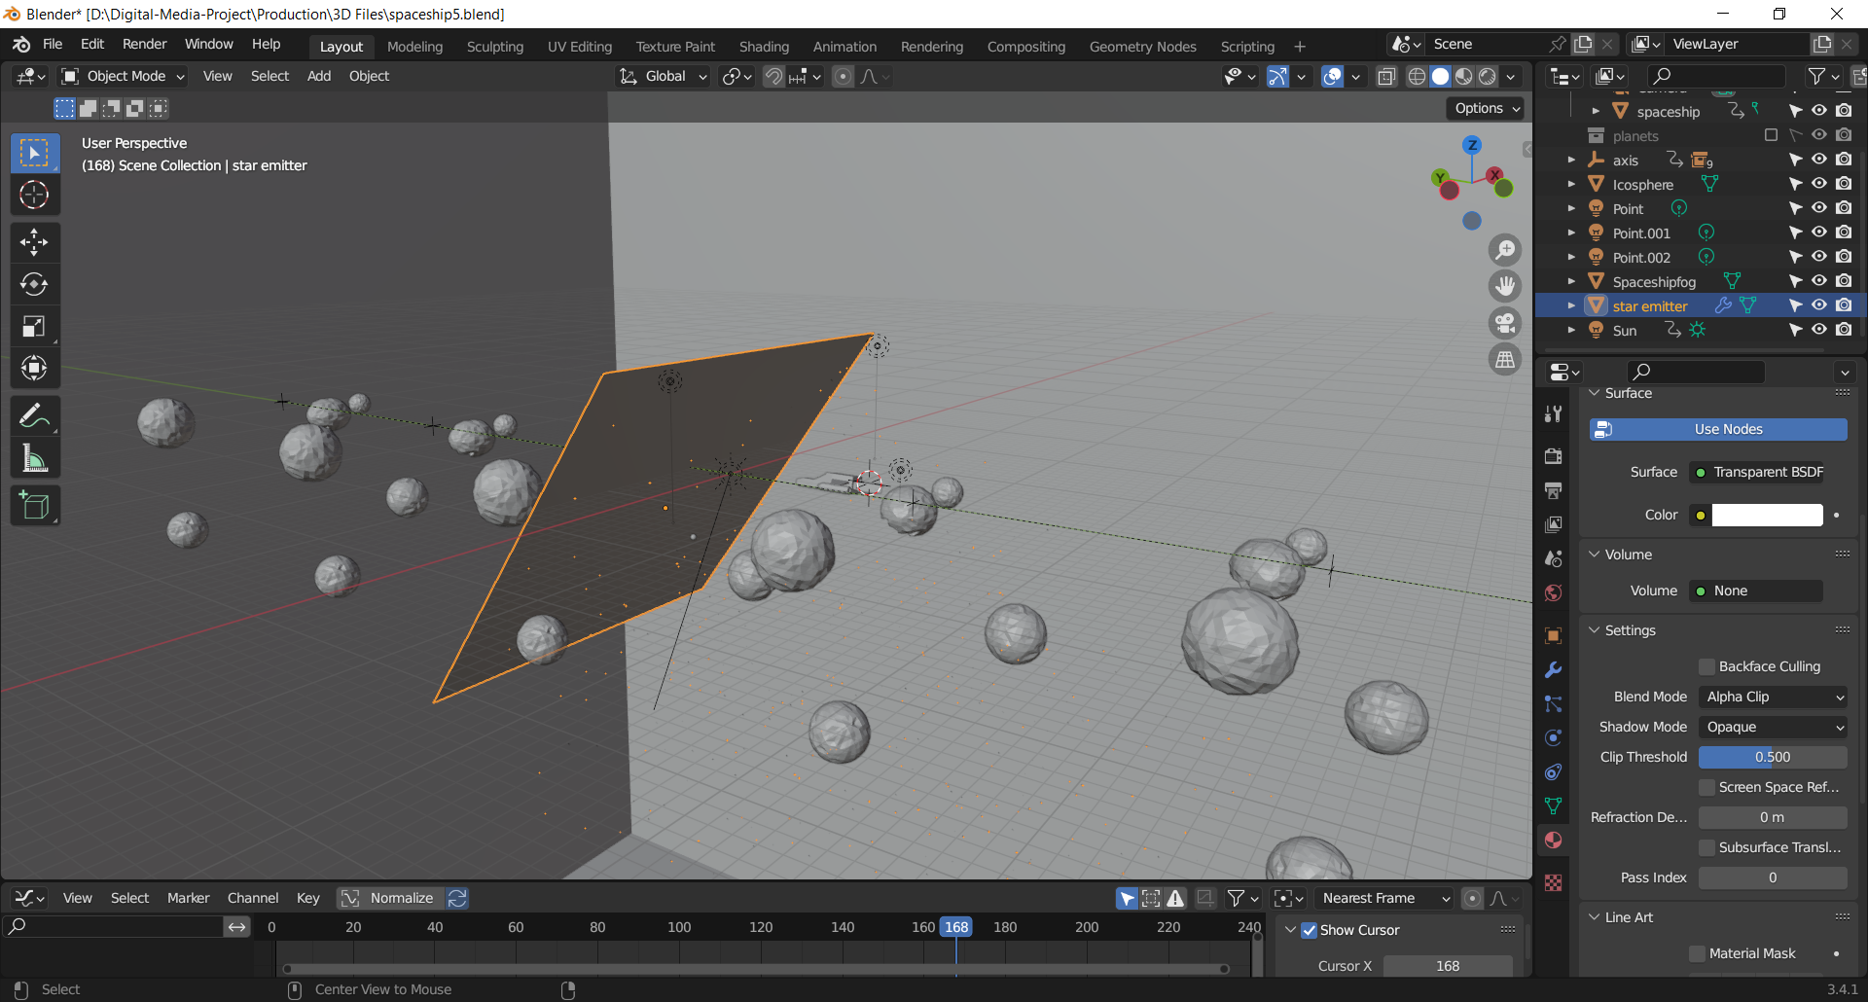
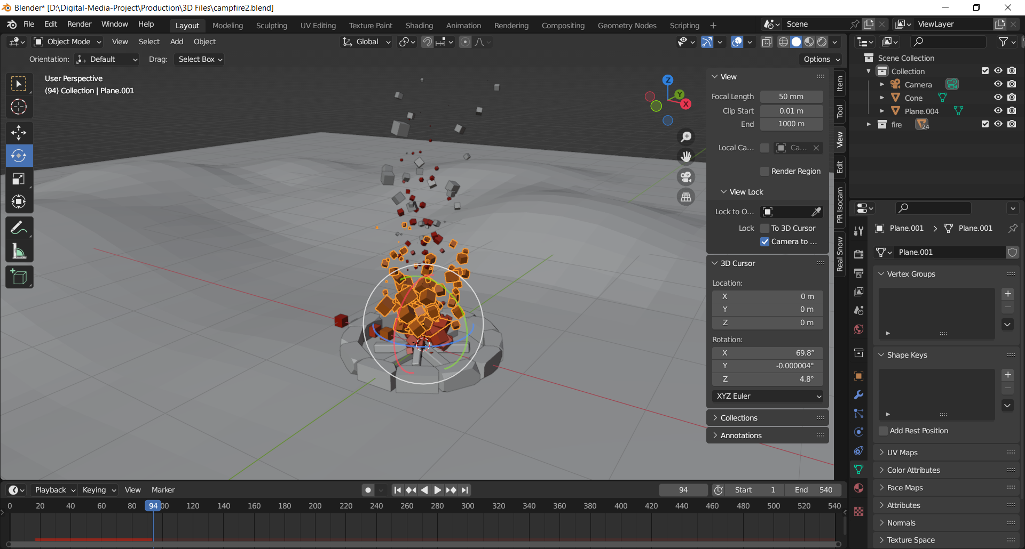
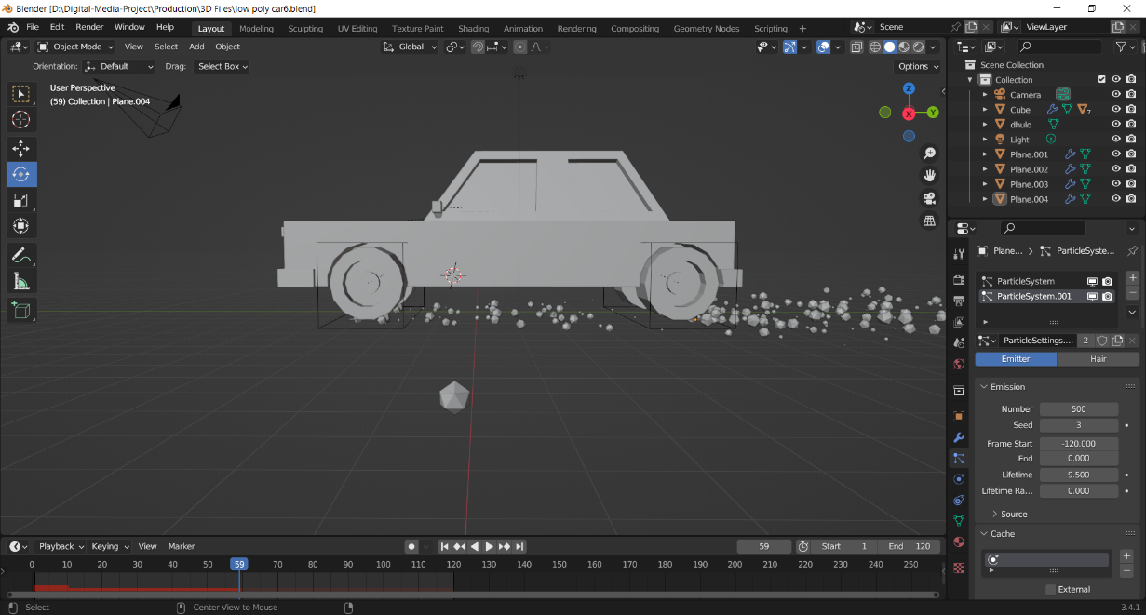

Slide 13
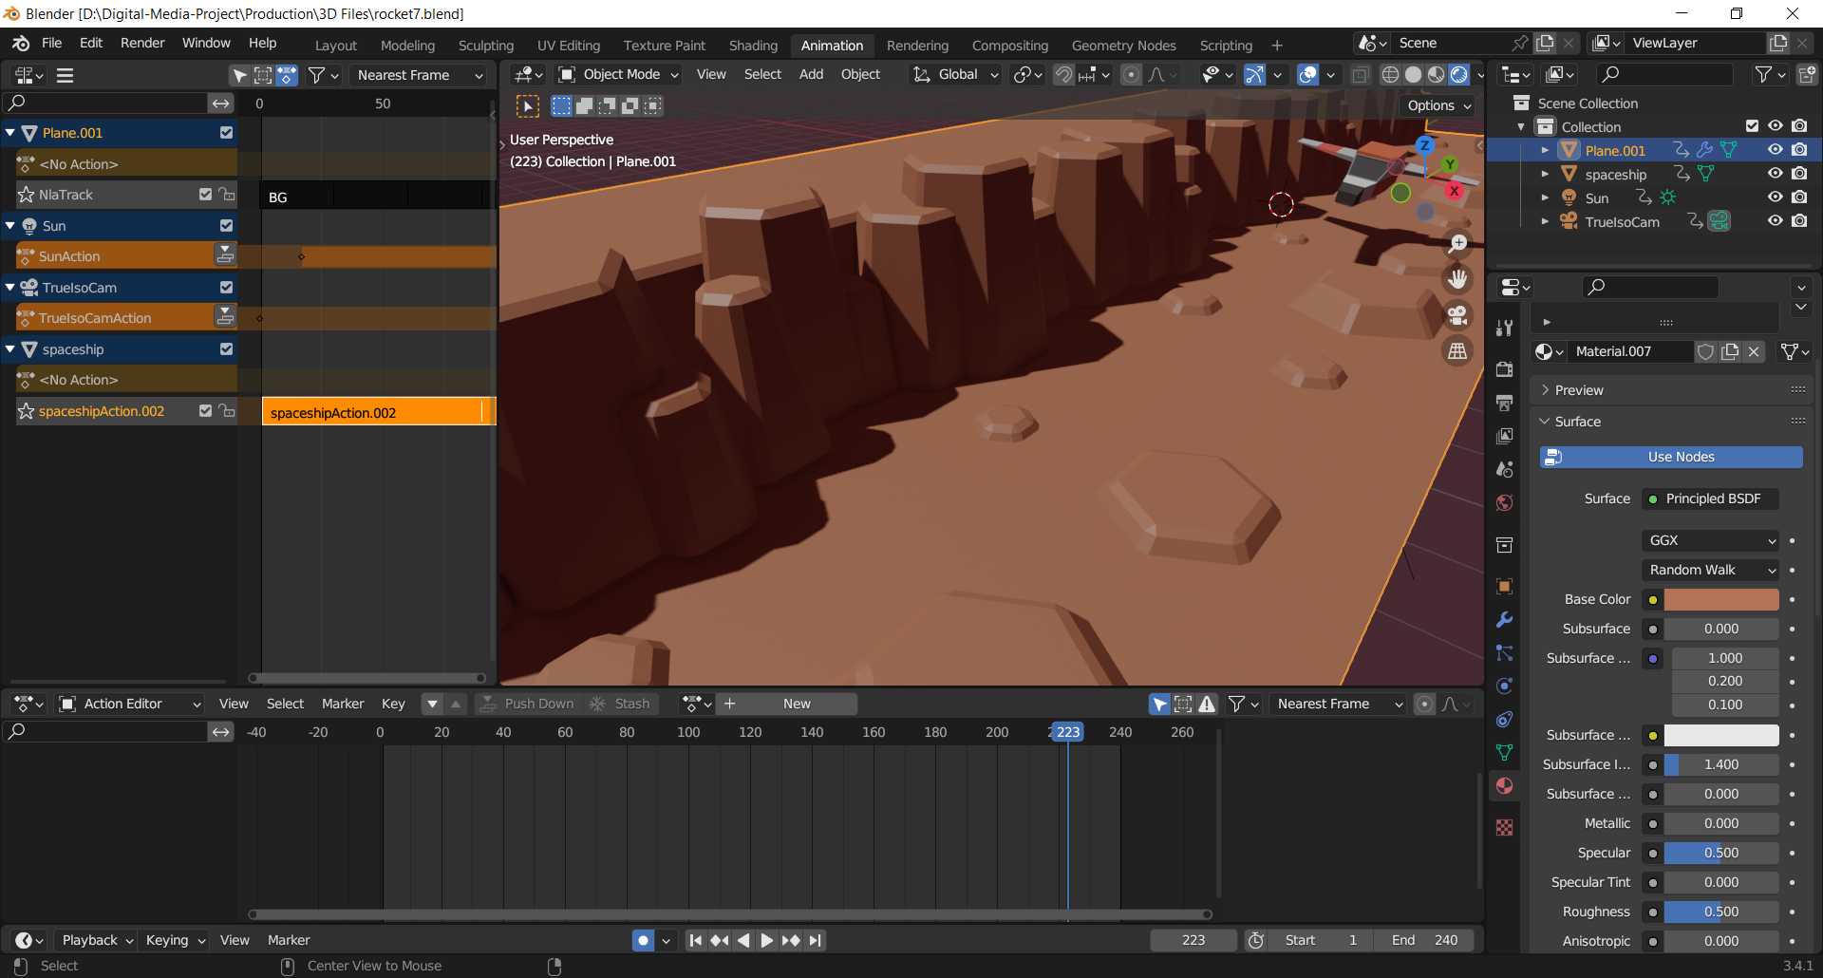
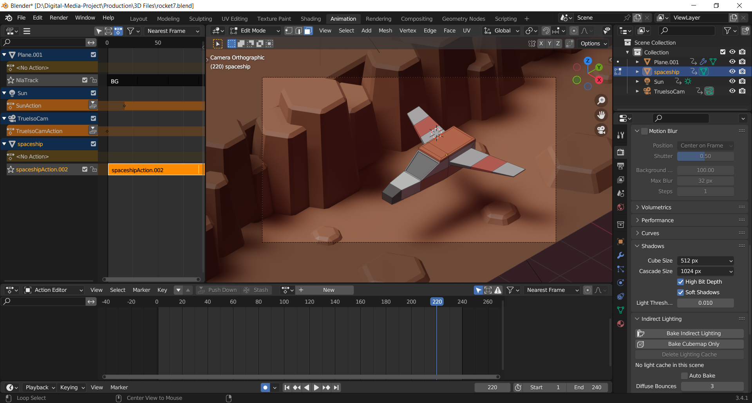
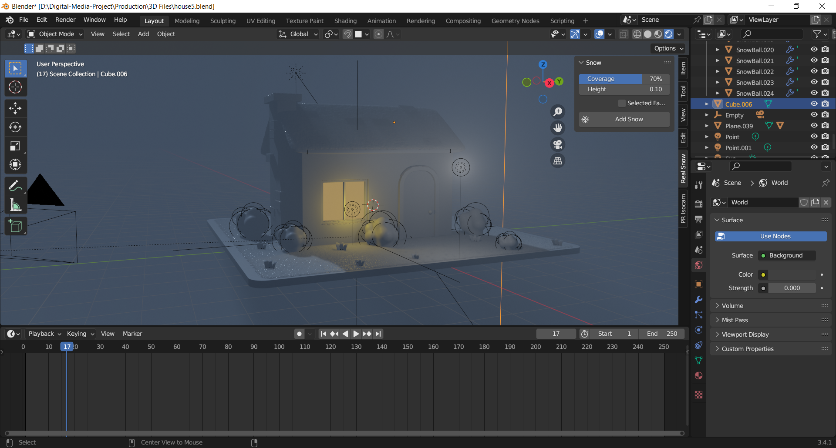
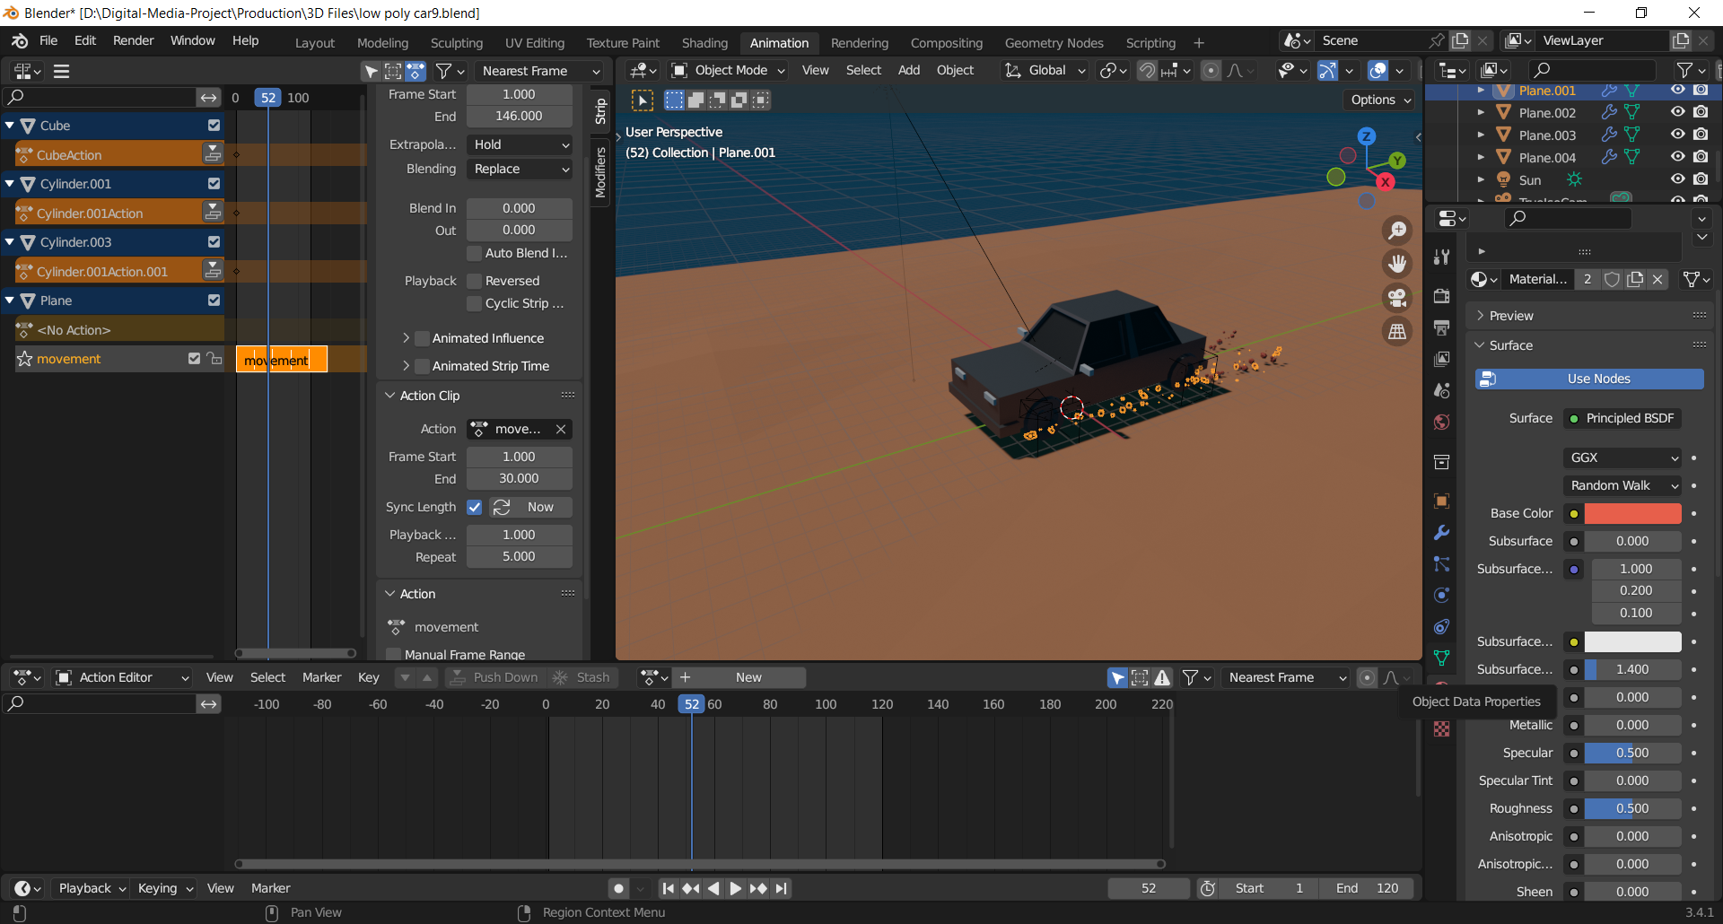
Shader setup

Slide 14
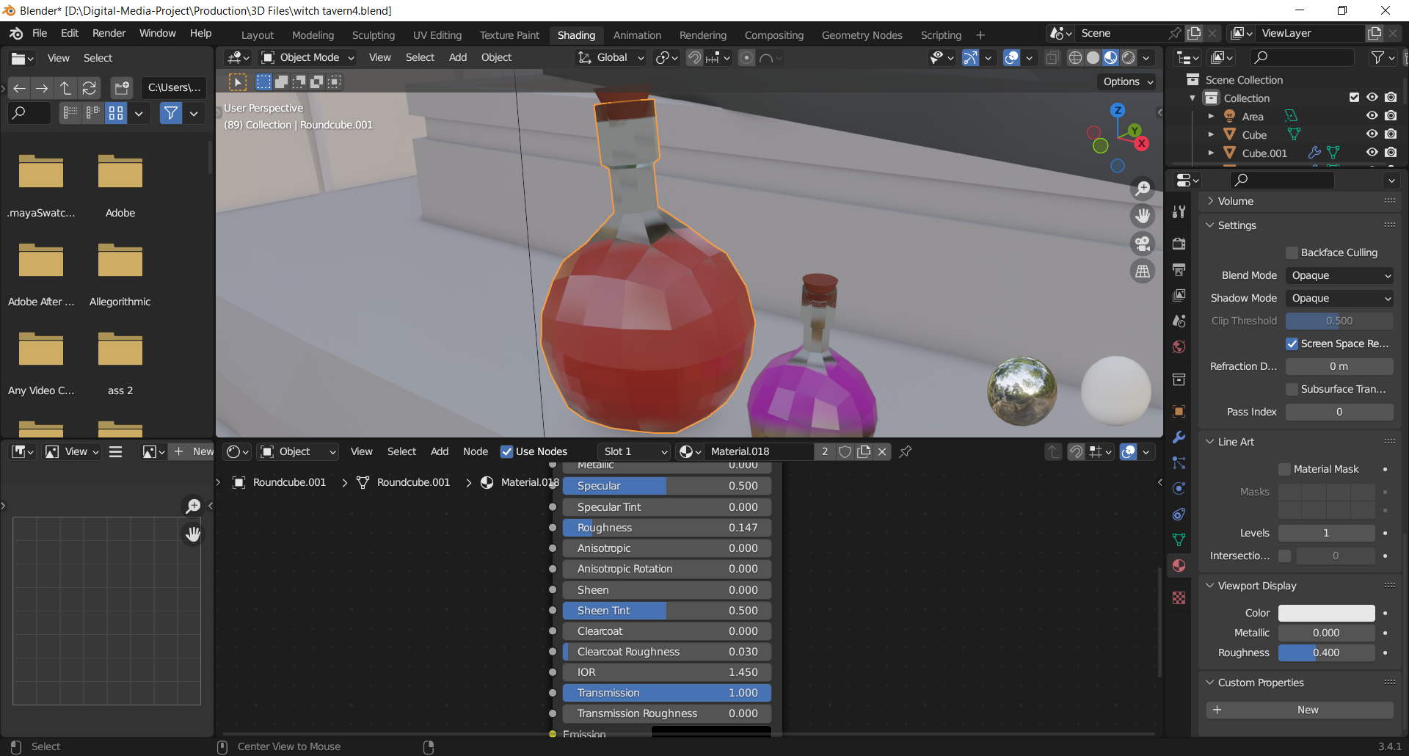
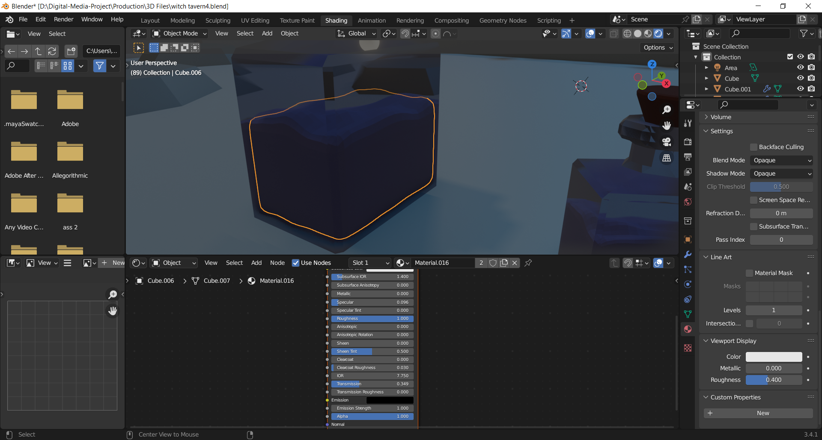
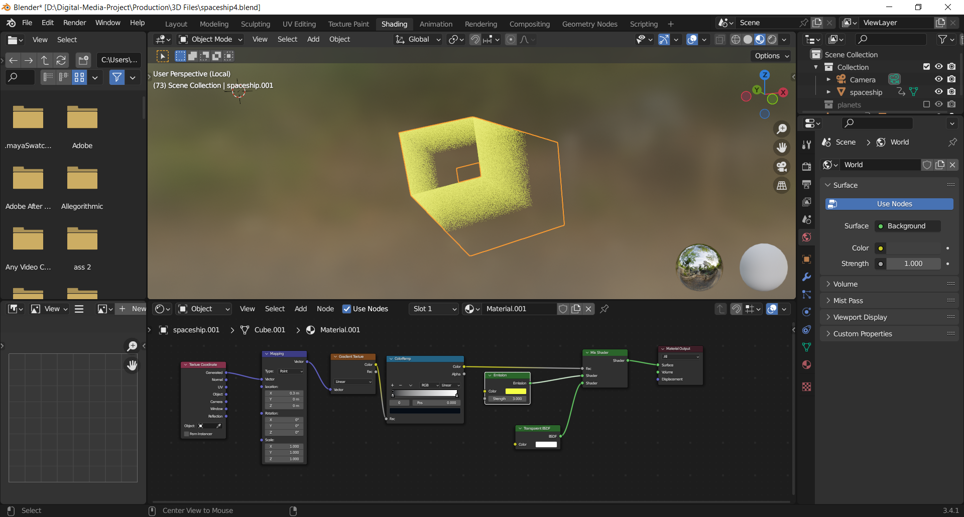
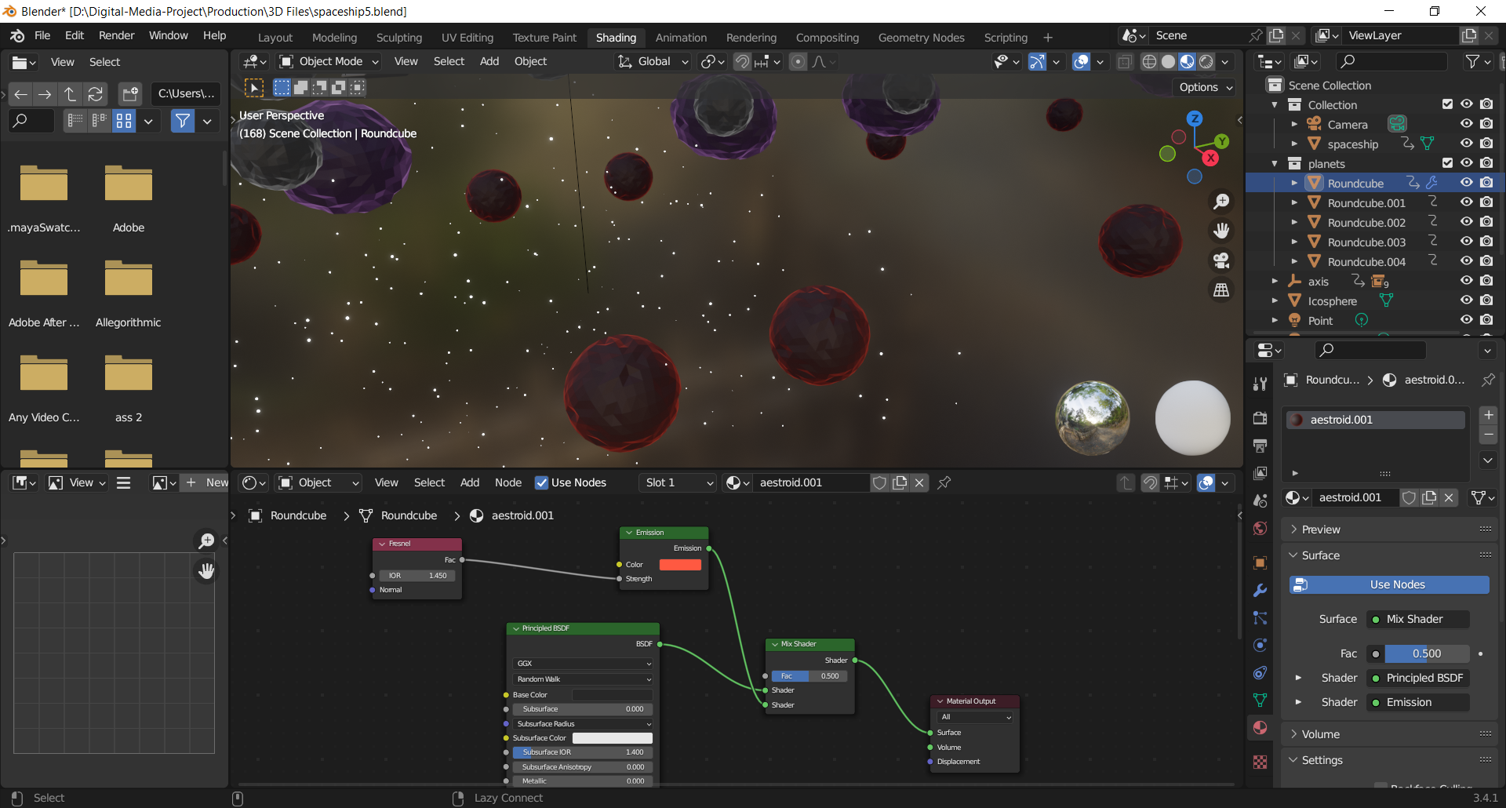

Slide 15
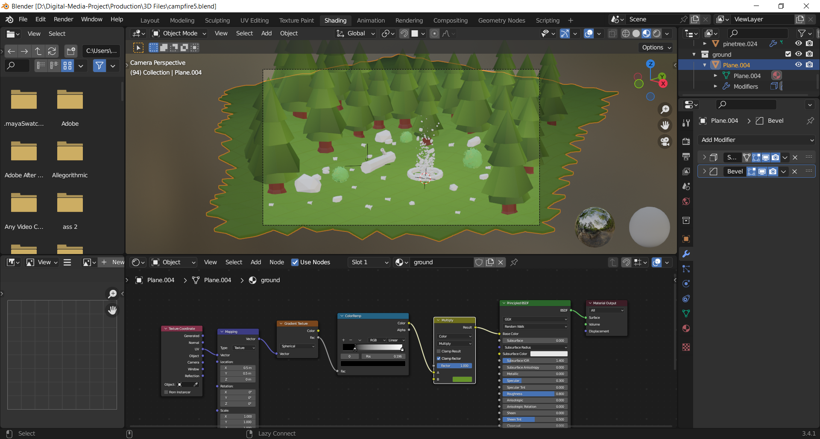
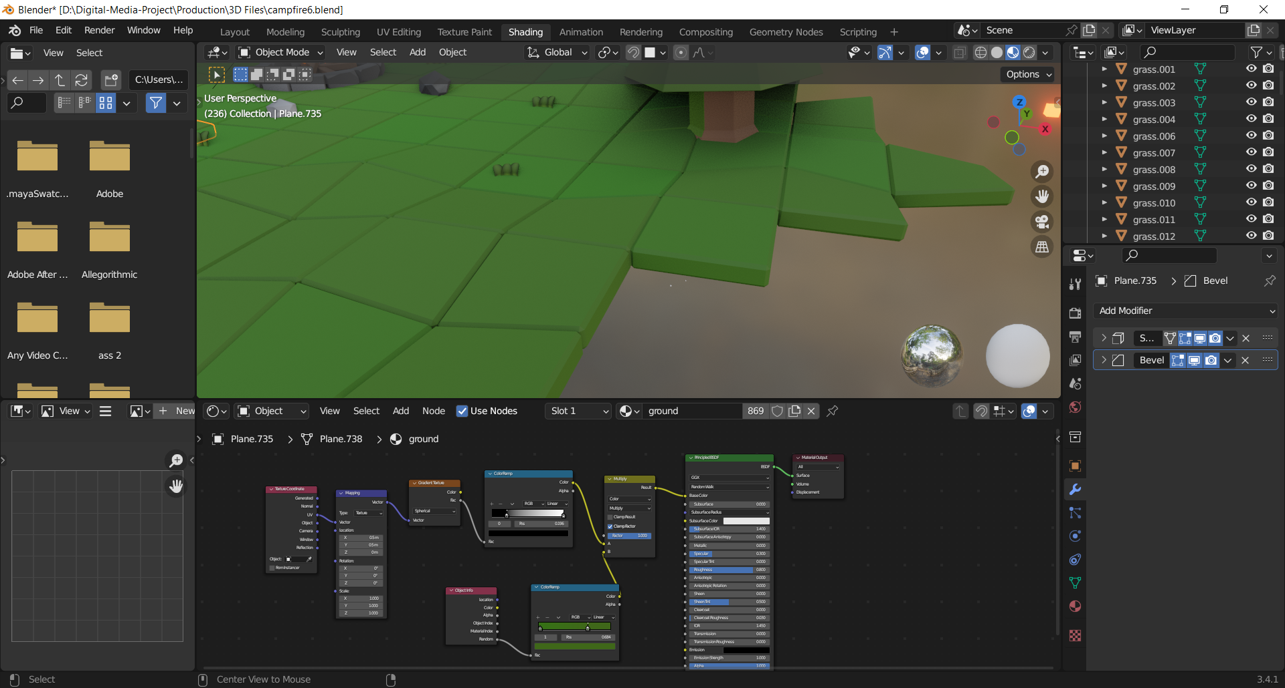

Slide 16
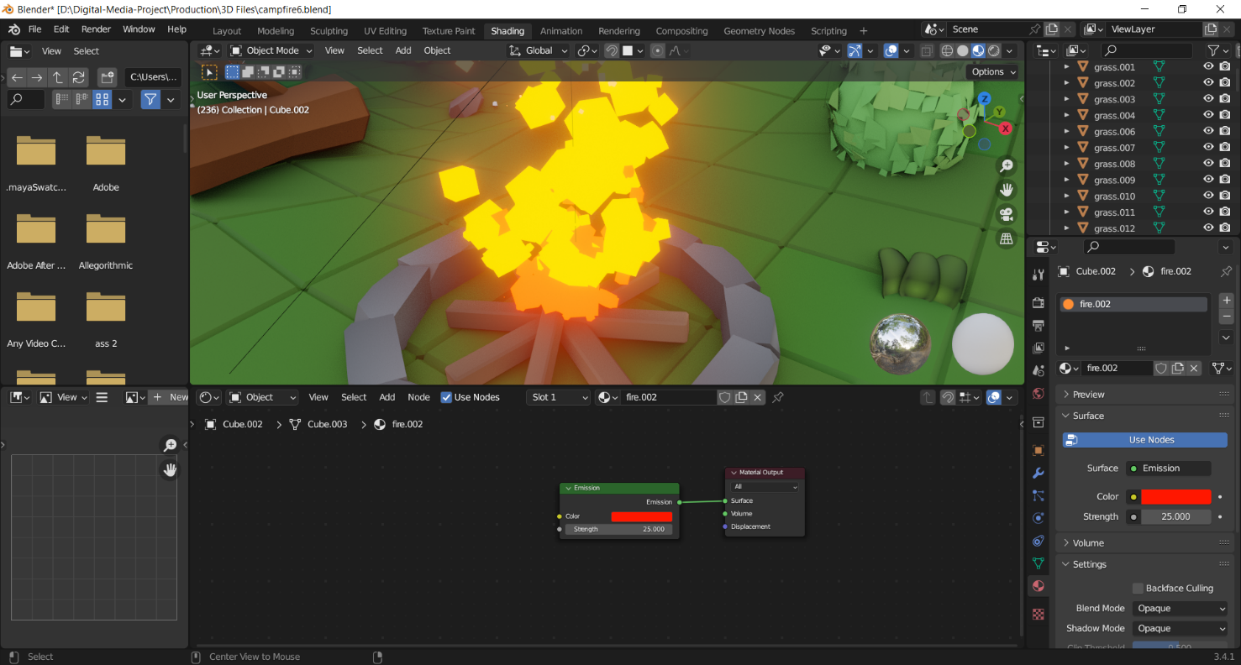

Slide 17
Post-production
photo here

Slide 18
Testing and Evaluation
Ma’am Esma garney k ho kasma? Group chat mai bhandhinu nah hai

Slide 20
Conclusion
Finally, I would like to thank my supervisors for their assistance with the project, I could not have finished it without their guidance. This project has helped me learn and gain knowledge of the utilization of assets in the indie game industry. It helped me in understanding about the scope and capabilities of my project. I hope to put my skills and knowledge in my future work.

